Slide 1
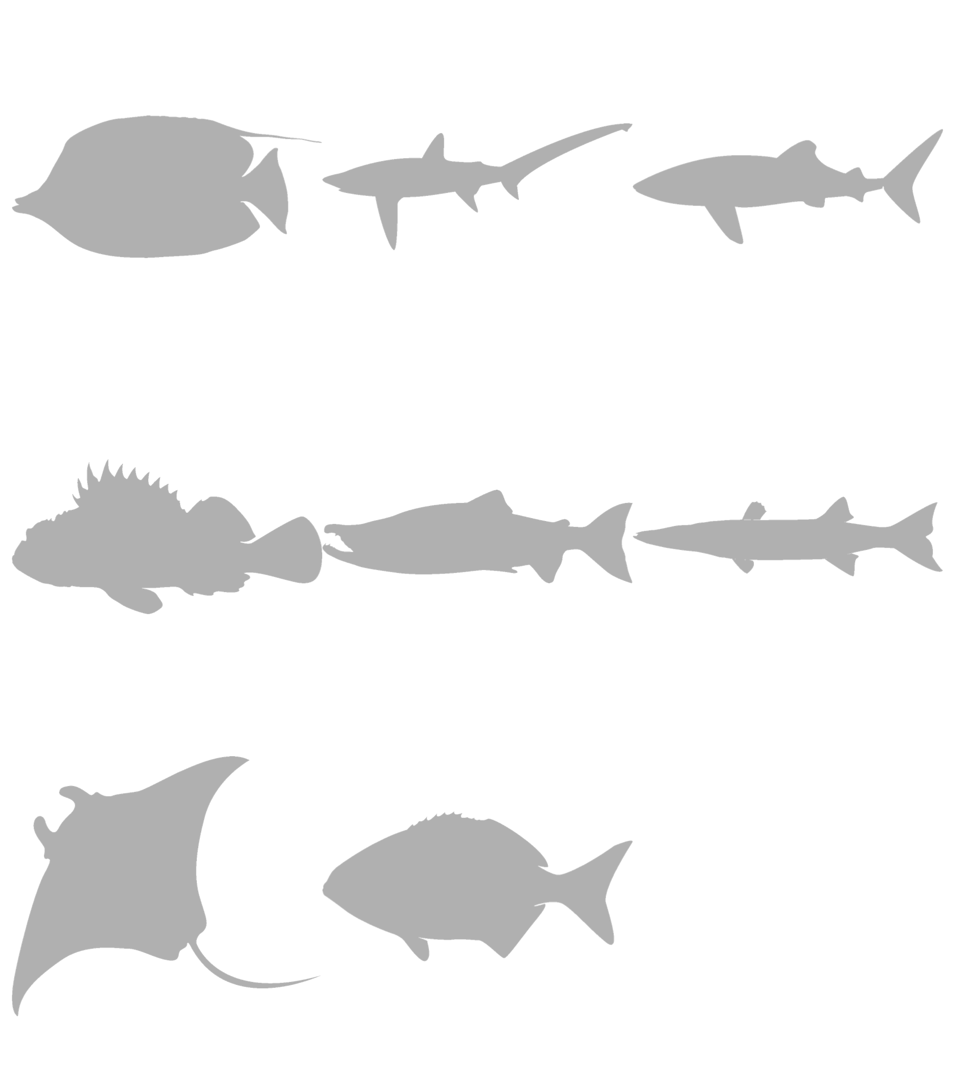
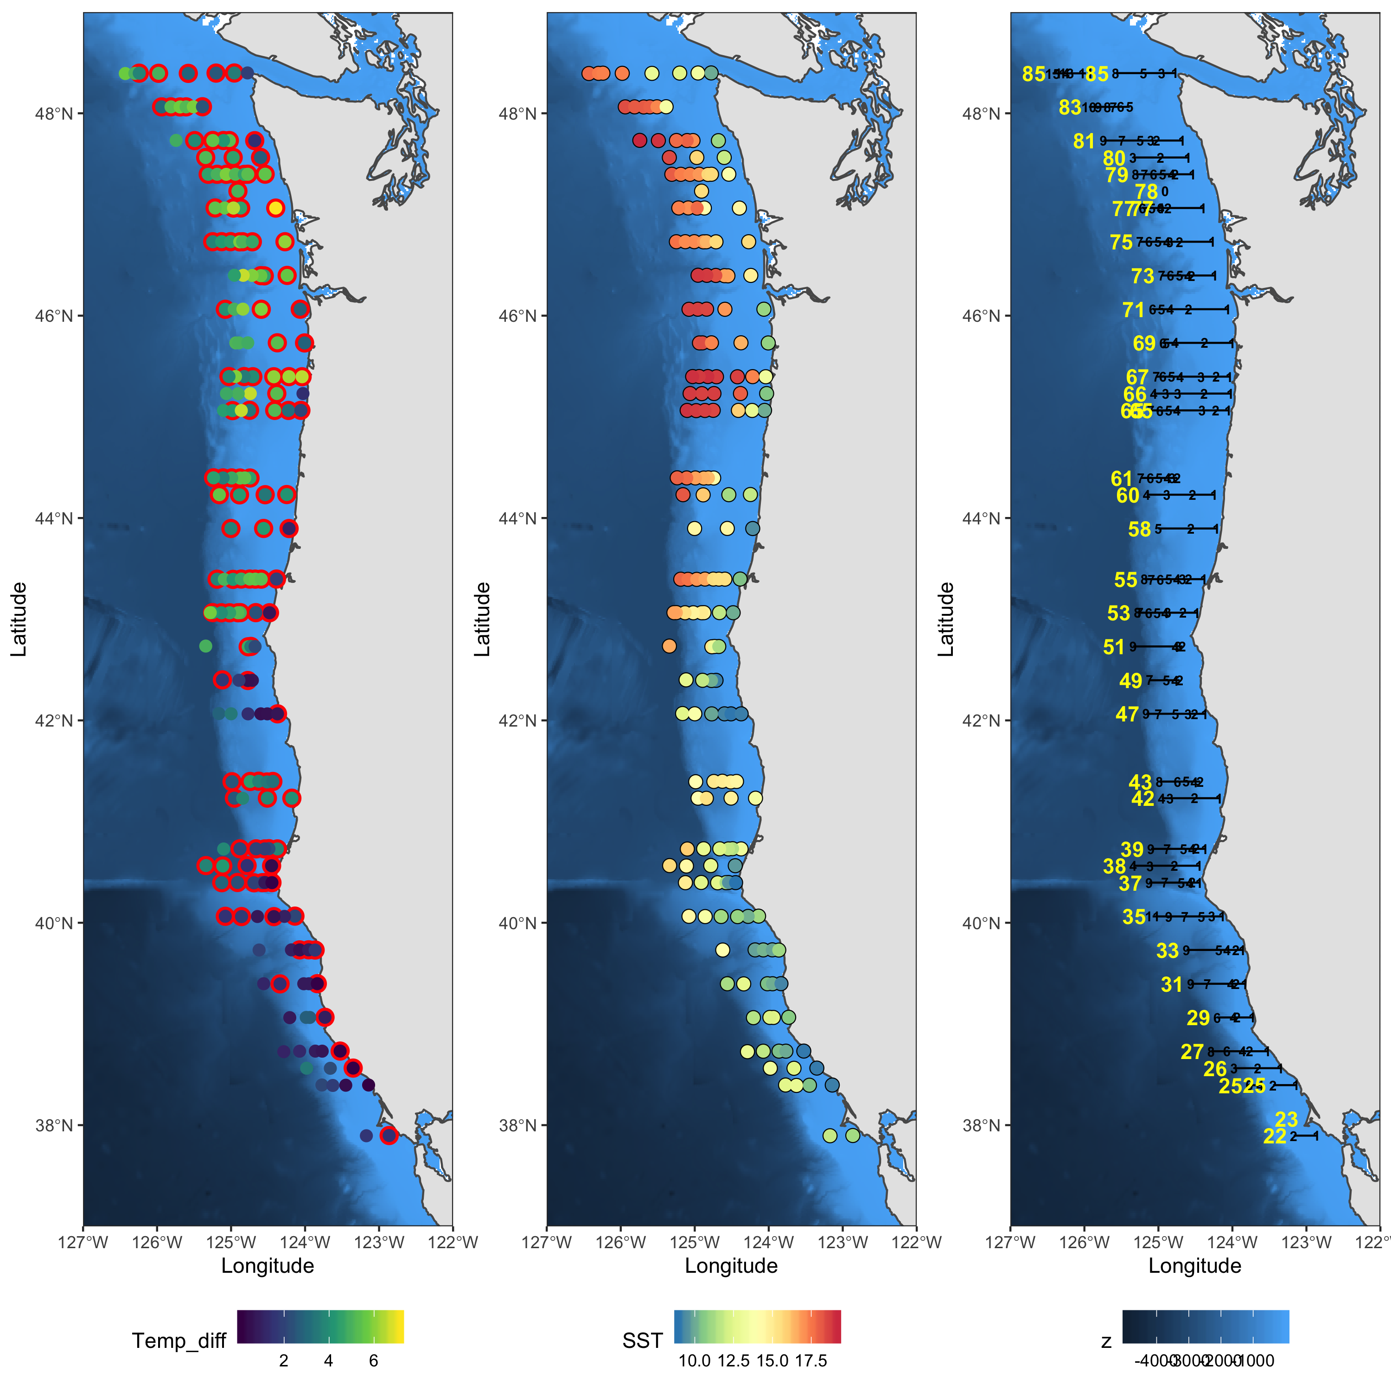

SPECIES DETECTION
STOCK ASSESMENT
ANADROMOUS
Fish Migration
MARINE COMMUNITIES
Developing methods
Simulation and Statistics
ENVIRONMENTAL Change
DIET ANALYSIS
HABs
Bioinformatics

Slide 2
MARINE COMMUNITIES
ENVIRONMENTAL Change
BIODIVERSITY SURVEYS
STOCK ASSESMENT
DIET ANALYSIS
ANADROMOUS
Fish Migration
HABs

Slide 3
MARINE COMMUNITIES
ENVIRONMENTAL Change
BIODIVERSITY SURVEYS
STOCK ASSESMENT
DIET ANALYSIS
ANADROMOUS
Fish Migration
HABs

Slide 4
MARINE COMMUNITIES
ENVIRONMENTAL Change
BIODIVERSITY SURVEYS
STOCK ASSESMENT
DIET ANALYSIS
ANADROMOUS
Fish Migration
HABs

Slide 5
MARINE COMMUNITIES
ENVIRONMENTAL Change
BIODIVERSITY SURVEYS
STOCK ASSESMENT
DIET ANALYSIS
ANADROMOUS
Fish Migration
HABs

Slide 6
MARINE COMMUNITIES
ENVIRONMENTAL Change
BIODIVERSITY SURVEYS
STOCK ASSESMENT
DIET ANALYSIS
ANADROMOUS
Fish Migration
HABs

Slide 7
MARINE COMMUNITIES
ENVIRONMENTAL Change
SPECIES DETECTION
Simulation and Statistics
Developing methods
Bioinformatics

Slide 8
MARINE COMMUNITIES
ENVIRONMENTAL Change

Slide 9
SPECIES DETECTION
STOCK ASSESMENT
ANADROMOUS
Fish Migration
MARINE COMMUNITIES
Simulation
And
Statistics
Developing methods
ENVIRONMENTAL Change
Bioinformatics
DIET ANALYSIS
HABs

Slide 10
SPECIES DETECTION
STOCK ASSESMENT
ANADROMOUS
Fish Migration
MARINE COMMUNITIES
Developing methods
Simulation and Statistics
ENVIRONMENTAL Change
DIET ANALYSIS
HABs
Bioinformatics

Slide 11
SPECIES DETECTION
STOCK ASSESMENT
ANADROMOUS
Fish Migration
MARINE COMMUNITIES
Developing methods
Simulation and Statistics
ENVIRONMENTAL Change
DIET ANALYSIS
HABs
Bioinformatics

Slide 12
SPECIES DETECTION
STOCK ASSESMENT
ANADROMOUS
Fish Migration
MARINE COMMUNITIES
Developing methods
Simulation and Statistics
ENVIRONMENTAL Change
DIET ANALYSIS
HABs
Bioinformatics

Slide 13
SPECIES DETECTION
STOCK ASSESMENT
ANADROMOUS
Fish Migration
MARINE COMMUNITIES
Simulation and Statistics
Developing methods
ENVIRONMENTAL Change
Bioinformatics
DIET ANALYSIS
HABs

Slide 14
SPECIES DETECTION
STOCK ASSESMENT
ANADROMOUS
Fish Migration
MARINE COMMUNITIES
Simulation and Statistics
Developing methods
ENVIRONMENTAL Change
DIET ANALYSIS
HABs
Bioinformatics

Slide 17
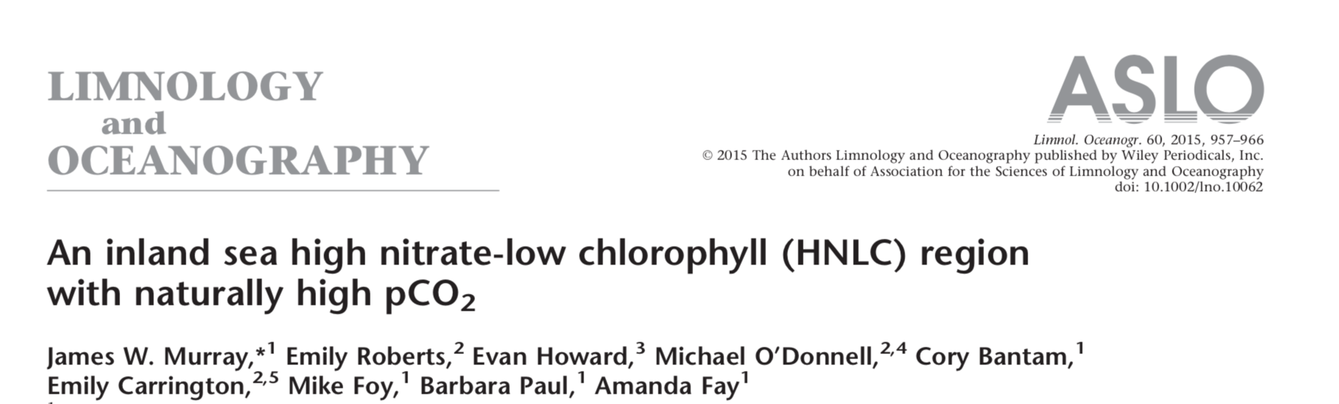
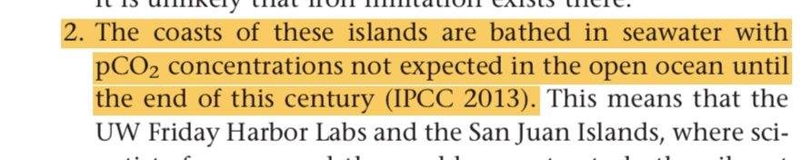

Slide 18
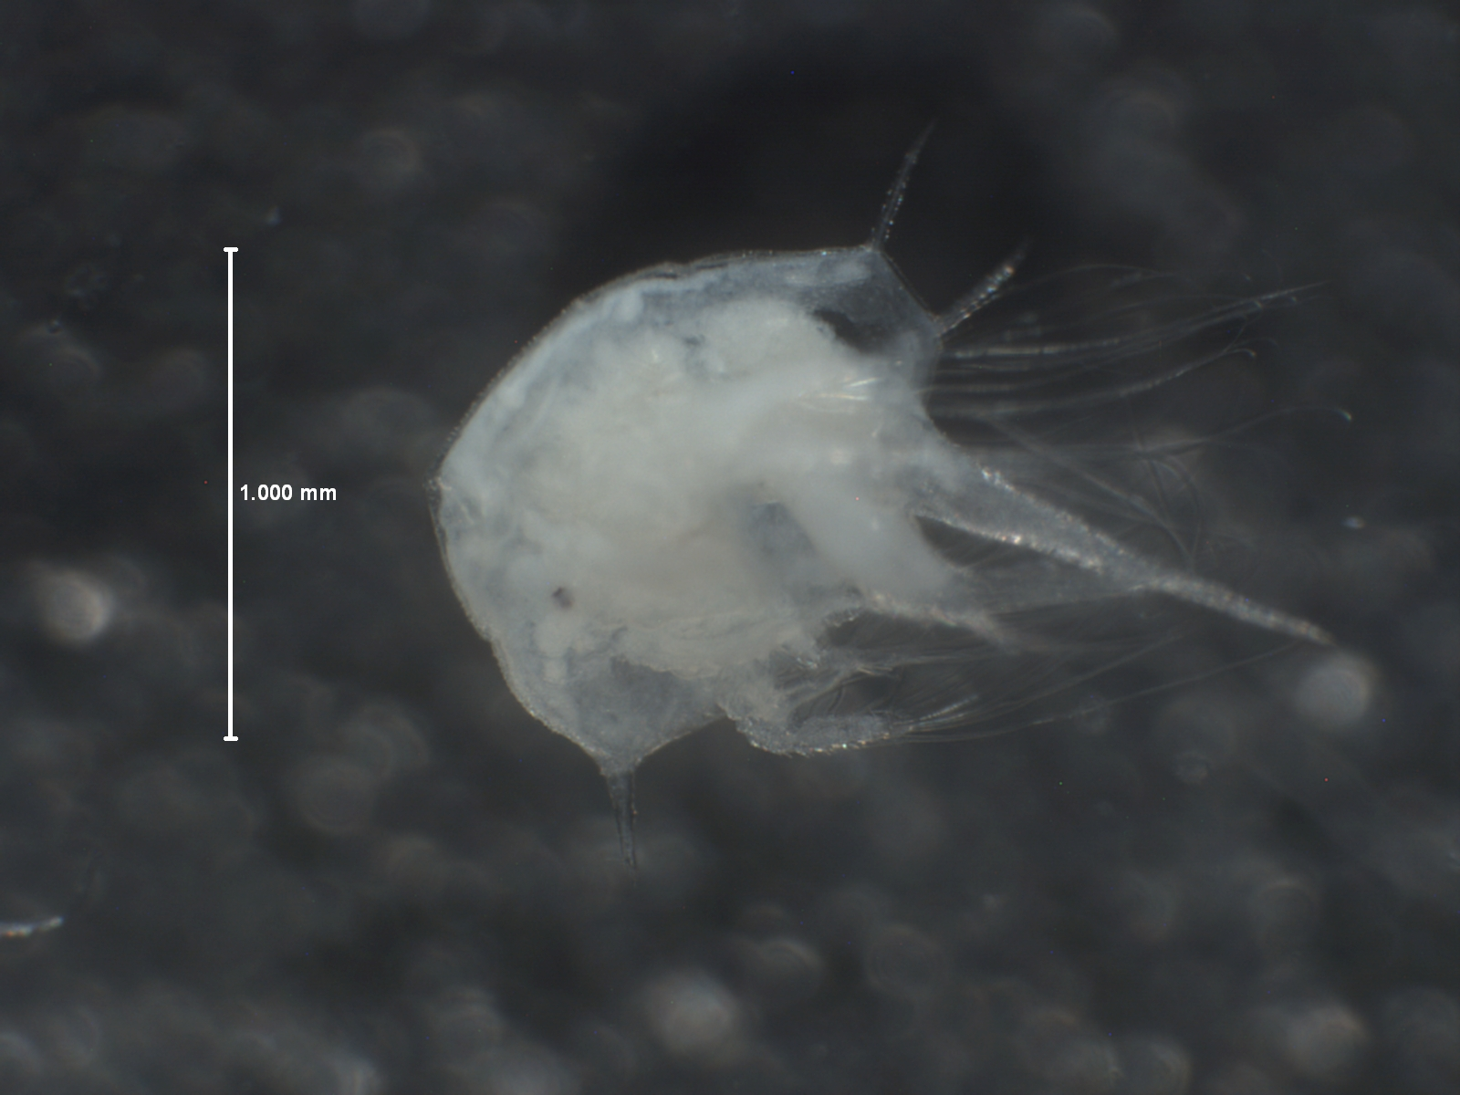

Slide 19
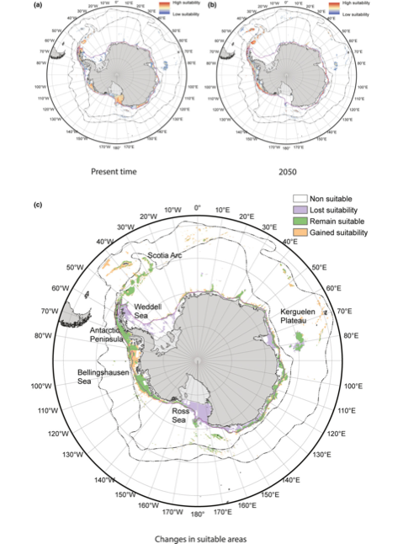
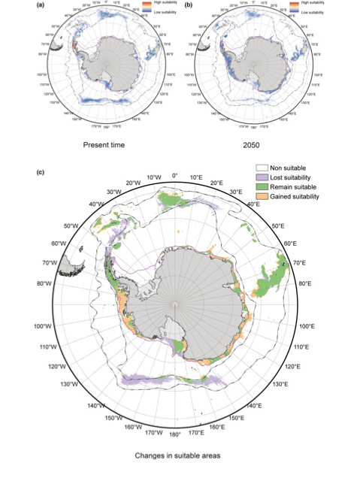

Slide 20
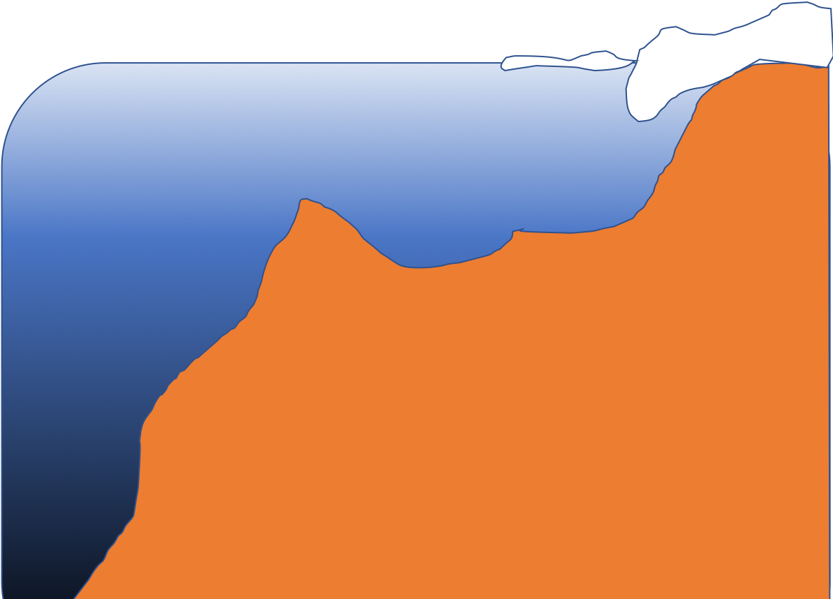

Slide 21


Slide 22
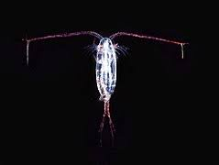
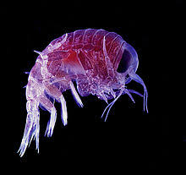
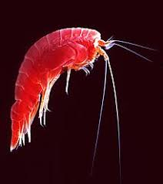
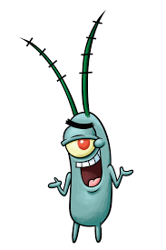
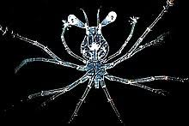
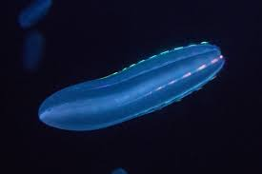
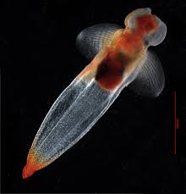
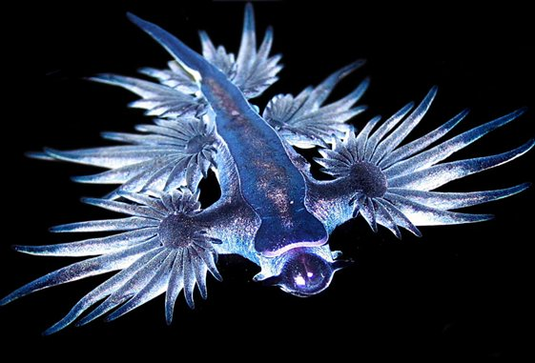
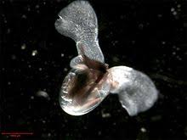

Slide 23



Slide 24
